Slide 1
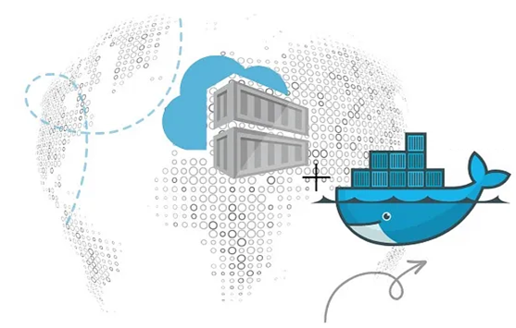
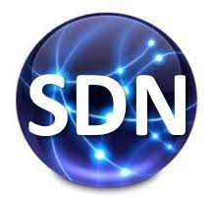
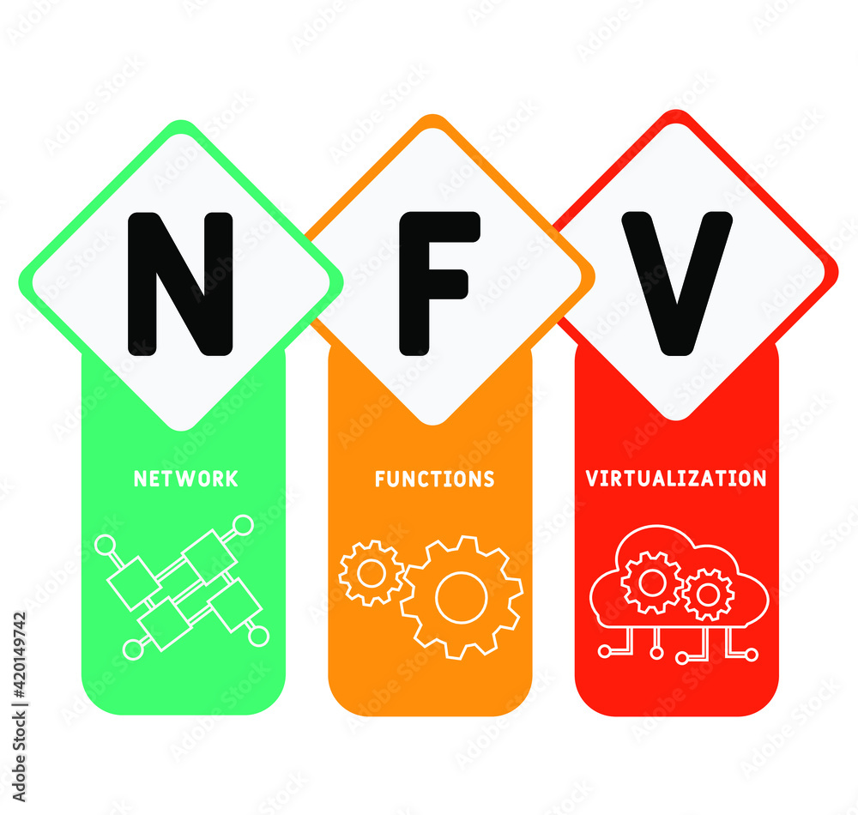
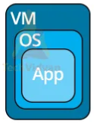
PDS
Computer Vision
Chapter 2:
Architecture Classification
ML, DL
https://github.com/siagianp
https://github.com/amelcharolinesgn2/IoT_simulator-mqtt-NodeRed
https://www.youtube.com/@AmelOline/videos
Notes:
https://medium.com/buildpiper/simplifying-containerization-with-docker-run-command-2f74e114f42a
https://github.com/IBA-Group-IT/IoT-data-simulator
https://www.bevywise.com/blog/docker-mqtt-broker-easy-service-manageability/

Slide 2
Architecture
ML
Convensional
DL
Architecture and Evaluate
Feature Extraction

Slide 3
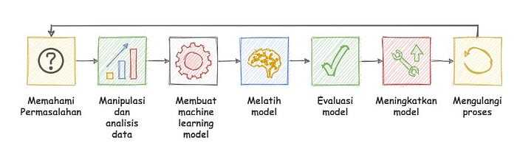
Tahapan ….
Memahami permasalahan. Jenis Machine Learning apa yang akan saya gunakan menurut data yang saya miliki?
Menganalisis dan memproses data. Data mana yang dapat digunakan? Data mana yang seharusnya dibuang? Pada tahap ini dilakukan pengolahan dan analisis data
Berdasarkan permasalahan dan data yang ada. Pada tahap ini Machine Learning Model dibuat.
Melatih program (Machine Learning Model). Model dilatih dengan memberikan data yang sudah diproses sebelumnya.
Melakukan evaluasi terhadap model. Apa yang salah dengan Model? Kenapa akurasinya rendah?
Meningkatkan model. Berdasarkan evaluasi, bagian model mana yang harus diubah? Pada tahap ini Machine Learning Model diperbarui.
Mengulangi semua proses
Notes:
https://medium.easyread.co/membuat-proyek-machine-learning-dengan-python-part-1-8e8a03095636

Slide 4
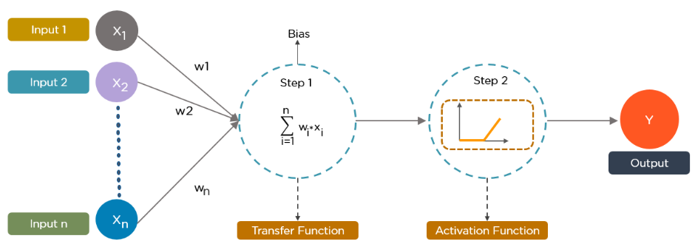
Neural network

Slide 5
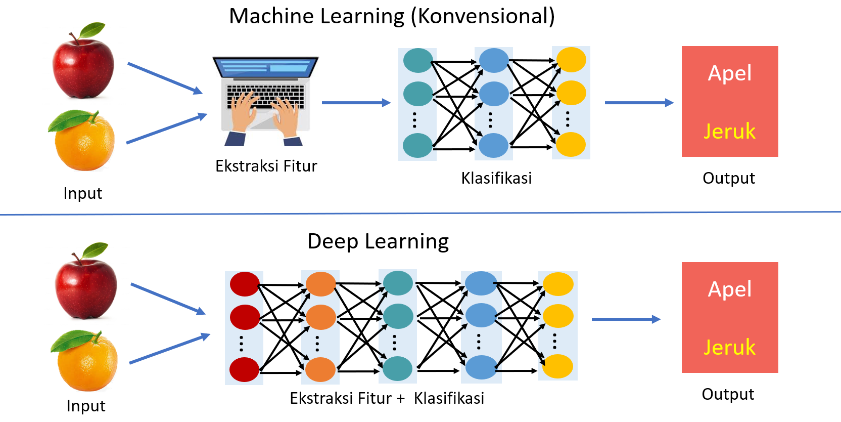

Slide 6
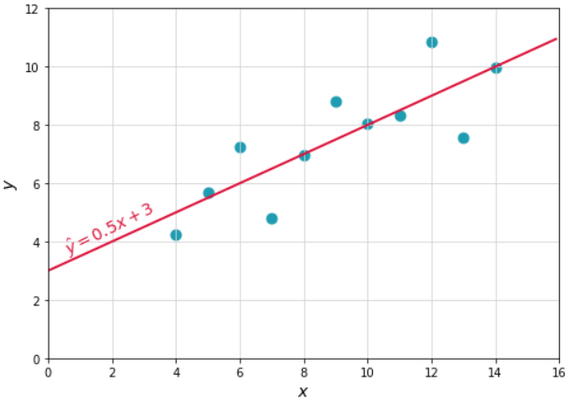
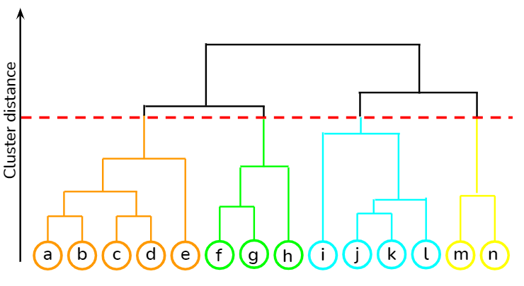
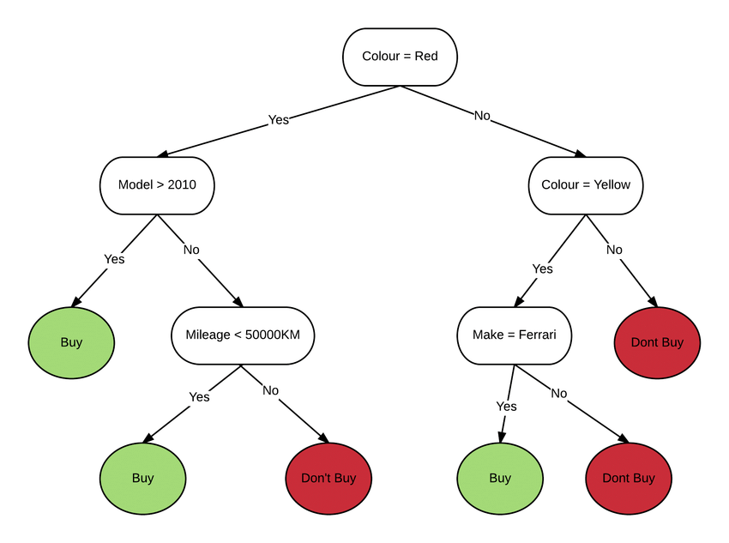
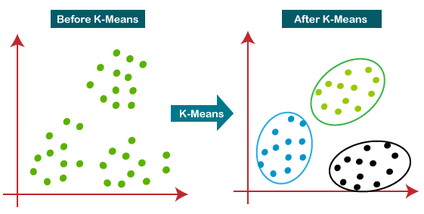
Algoritma Machine Learning!
Linear Regression
Hierarchical Clustering
# Import standard library
import pandas as pd
import numpy as np
import matplotlib.pyplot as plt
import seaborn as sns
# Memuat file suhu.csv menjadi pandas dataframe
dataframe = pd.read_csv(‘suhu.csv')
# Menampilkan 5 baris pertama dari dataframe
dataframe.head()
# Melakukan proses hierarchy
from scipy.cluster.hierarchy import dendrogram, linkage
Decision Tree
K-Means Clustering
Notes:
https://dqlab.id/4-contoh-algoritma-machine-learning-menggunakan-python

Slide 7
Algoritma Deep Learning!
Convolutional Neural Networks (CNNs)
RNN atau Recurrent Neural Network
Long Short-Term Memory Networks (LSTMs)
Generative Adversarial Networks (GANs)
Autoencoders
Variational Autoencoders (VAEs)
Deep Belief Networks (DBNs)
Notes:
https://dqlab.id/4-contoh-algoritma-machine-learning-menggunakan-python
https://www.simplilearn.com/tutorials/deep-learning-tutorial/deep-learning-algorithm

Slide 8
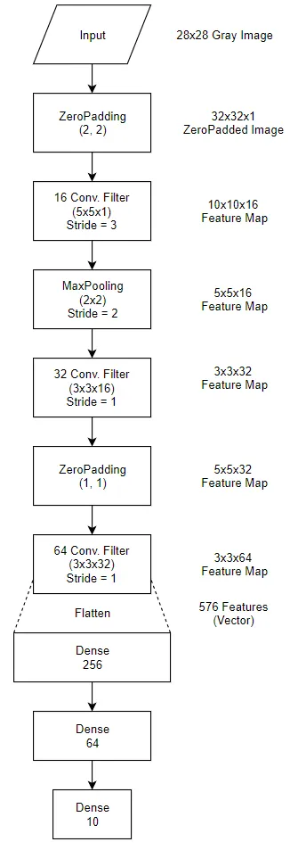
Model
Algoritma Deep Learning!
# Feature Extraction Layer
inputs = Input(shape=(28, 28, 1))
conv_layer = ZeroPadding2D(padding=(2,2))(inputs)
conv_layer = Conv2D(16, (5, 5), strides=(3,3), activation='relu')(conv_layer)
conv_layer = MaxPooling2D((2, 2))(conv_layer)
conv_layer = Conv2D(32, (3, 3), strides=(1,1), activation='relu')(conv_layer)
conv_layer = ZeroPadding2D(padding=(1,1))(conv_layer)
conv_layer = Conv2D(64, (3, 3), strides=(1,1), activation='relu')(conv_layer)
# Flatten feature map to Vector with 576 element.
flatten = Flatten()(conv_layer)
# Fully Connected Layer
fc_layer = Dense(256, activation='relu')(flatten)
fc_layer = Dense(64, activation='relu')(fc_layer)
outputs = Dense(10, activation='softmax')(fc_layer)
model = Model(inputs=inputs, outputs=outputs)
# Adam Optimizer and Cross Entropy Loss
adam = Adam(lr=0.0001)
model.compile(optimizer=adam, loss='categorical_crossentropy', metrics=['accuracy'])
# Print Model Summary
print(model.summary())

Slide 9
Algoritma Deep Learning!
CNN-3D
model = Sequential()
model.add(layers.Conv3D(32,(3,3,3),activation='relu',input_shape=(16,16,16,1),bias_initializer=Constant(0.01)))
model.add(layers.Conv3D(32,(3,3,3),activation='relu',bias_initializer=Constant(0.01)))
model.add(layers.MaxPooling3D((2,2,2)))
model.add(layers.Conv3D(64,(3,3,3),activation='relu'))
model.add(layers.Conv3D(64,(2,2,2),activation='relu'))
model.add(layers.MaxPooling3D((2,2,2)))
model.add(layers.Dropout(0.6))
model.add(layers.Flatten())
model.add(layers.Dense(256,'relu'))
model.add(layers.Dropout(0.7))
model.add(layers.Dense(128,'relu'))
model.add(layers.Dropout(0.5))
model.add(layers.Dense(10,'softmax'))
model.summary()
Convolutional Neural Networks (CNNs)
RNN atau Recurrent Neural Network
Long Short-Term Memory Networks (LSTMs)
Model: "sequential_2"
_________________________________________________________________
Layer (type) Output Shape Param #
=================================================================
conv3d_5 (Conv3D) (None, 14, 14, 14, 32) 896
_________________________________________________________________
conv3d_6 (Conv3D) (None, 12, 12, 12, 32) 27680
_________________________________________________________________
max_pooling3d_2 (MaxPooling3 (None, 6, 6, 6, 32) 0
_________________________________________________________________
conv3d_7 (Conv3D) (None, 4, 4, 4, 64) 55360
_________________________________________________________________
conv3d_8 (Conv3D) (None, 3, 3, 3, 64) 32832
_________________________________________________________________
max_pooling3d_3 (MaxPooling3 (None, 1, 1, 1, 64) 0
_________________________________________________________________
dropout_4 (Dropout) (None, 1, 1, 1, 64) 0
_________________________________________________________________
flatten_1 (Flatten) (None, 64) 0
_________________________________________________________________
dense_3 (Dense) (None, 256) 16640
_________________________________________________________________
dropout_5 (Dropout) (None, 256) 0
_________________________________________________________________
dense_4 (Dense) (None, 128) 32896
_________________________________________________________________
dropout_6 (Dropout) (None, 128) 0
_________________________________________________________________
dense_5 (Dense) (None, 10) 1290
=================================================================
Total params: 167,594
Trainable params: 167,594
Non-trainable params: 0
Generative Adversarial Networks (GANs)
Autoencoders
Variational Autoencoders (VAEs)
Deep Belief Networks (DBNs)
Notes:
https://dqlab.id/4-contoh-algoritma-machine-learning-menggunakan-python
https://www.simplilearn.com/tutorials/deep-learning-tutorial/deep-learning-algorithm

Slide 10
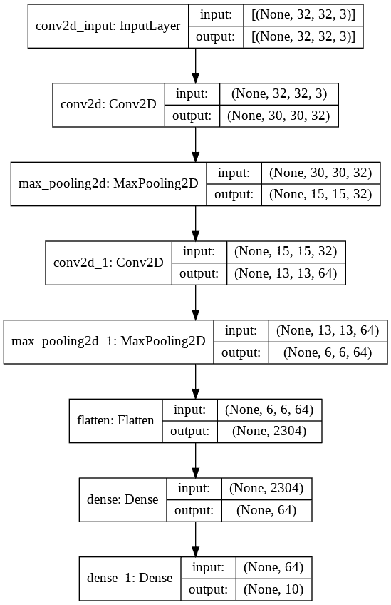
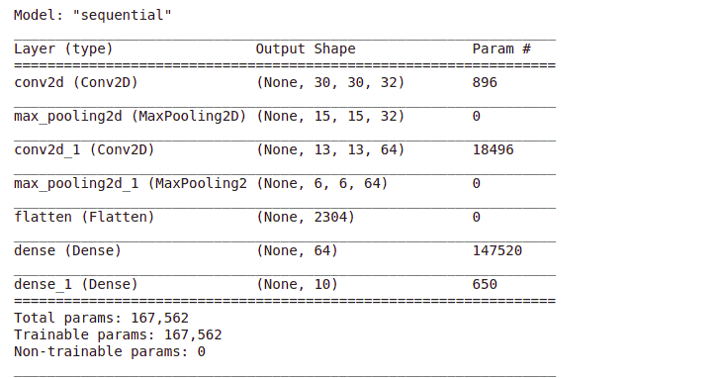
CNN-2D
tf.keras.utils.plot_model(
model,
to_file="model.png",
show_shapes=True,
show_layer_names=True,
rankdir="TB",
expand_nested=True,
dpi=96,
)
model = tf.keras.Sequential(
[
tf.keras.layers.Conv2D(32, (3,3), padding='same', activation="relu",input_shape=(32, 32, 3)),
tf.keras.layers.MaxPooling2D((2, 2), strides=2),
tf.keras.layers.Conv2D(64, (3,3), padding='same', activation="relu"),
tf.keras.layers.MaxPooling2D((2, 2), strides=2),
tf.keras.layers.Flatten(),
tf.keras.layers.Dense(100, activation="relu"),
tf.keras.layers.Dense(10, activation="softmax")
]
)
model.summary()
https://www.tensorflow.org/tutorials/video/video_classification
https://www.analyticsvidhya.com/blog/2022/05/building-a-3d-cnn-in-tensorflow/
https://glassboxmedicine.com/2021/02/06/designing-custom-2d-and-3d-cnns-in-pytorch-tutorial-with-code/
https://cnvrg.io/cnn-tensorflow/
https://medium.com/@samuelsena/pengenalan-deep-learning-part-7-convolutional-neural-network-cnn-b003b477dc94

Slide 11
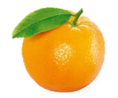
Conventional classification
The conventional classification approach generally performs feature extraction separately and then continues the learning process using conventional classification methods such as Decision Tree, SVM, or ANN.
Praproses
Ekstraksi Fitur
Klasifikasi
Jeruk

Slide 12
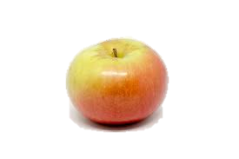
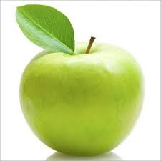
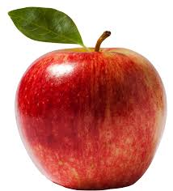
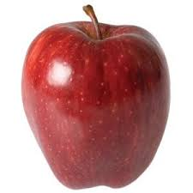
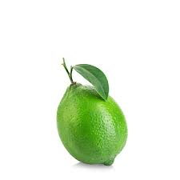
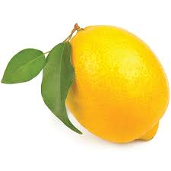
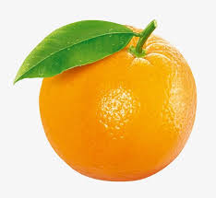
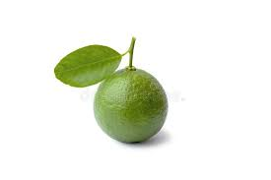
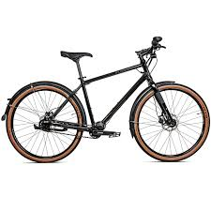

Conventional classification
Ekstraksi Fitur
Klasifikasi
Warna
Bentuk
Tekstur
Warna
Bentuk
Tekstur
Ukuran
Apel
…
Jeruk
Kelemahan
Memerlukan waktu dan pengetahuan lebih untuk ekstraksi fitur
Sangat tergantung pada satu domain permasalahan saja sehingga tidak berlaku general
No | Warna | Bentuk | Tekstur | Kelas
1 | Merah | Bulat | Halus | Apel
2 | Hijau | Bulat | Halus | Apel
3 | Kuning | Lonjong | Kasar | Jeruk
…
N | Hijau | Lonjong | Kasar | Jeruk
No | Warna | Bentuk | Tekstur | Ukuran | Kelas
1 | Merah | Bulat | Halus | Besar | Apel
2 | Hijau | Bulat | Halus | Sedang | Apel
3 | Kuning | Lonjong | Kasar | Besar | Jeruk
…
N-1 | Hjiau | Lonjong | Kasar | Sedang | Jeruk
N | Hijau | Bulat | Halus | Kecil | Jeruk

Slide 13
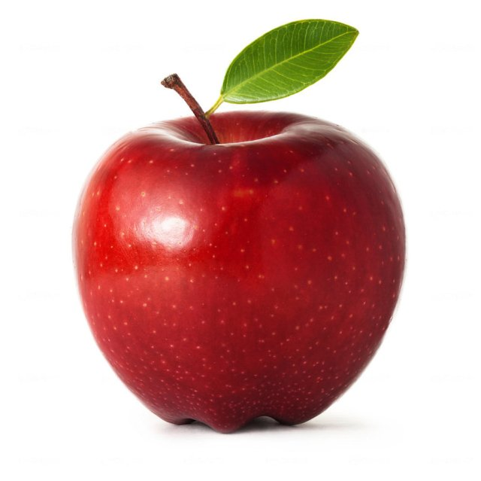
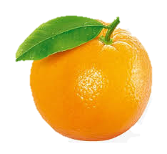
Deep learning classification
Deep learning-based object recognition learns hierarchical representations (feature patterns) automatically through several stages of the feature learning process
Apel
Jeruk
…
…
…
…
…
Ekstraksi Fitur + Klasifikasi
Output
Input
Feature learning
Low-level feature
Mid-level feature
High-level feature
Notes:
Pengenalan obyek berbasis Deep learning mempelajari representasi hirarki (pola fitur) secara otomatis melalui beberapa tahapan proses feature learning

Slide 14
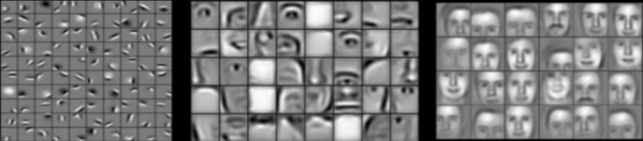
Deep learning classification
The hierarchy in the feature representation shows the increasing level of abstraction.
Each stage is a feature learning process in feature transformation
Kenaikan level abstraksi
Low-level feature
Mid-level feature
High-level feature

Slide 15
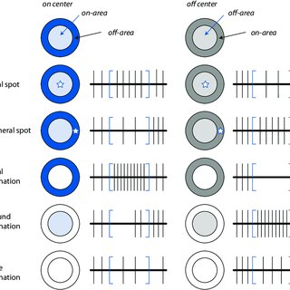
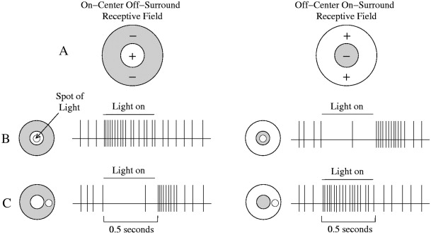
Deep learning classification
Notes:
Seirama dengan penelitian huble, mencari respon otak kucing terhadap pergerakan.

Slide 16
Deep Neural network
Layer 1
Layer 2
Layer 3
Layer 4
Layer L
Output
…….
y₁
…….
y₂
……
……
……
……
……
……
……
….…
y_{M}
Input Layer
Output Layer
Hidden Layers

Slide 17
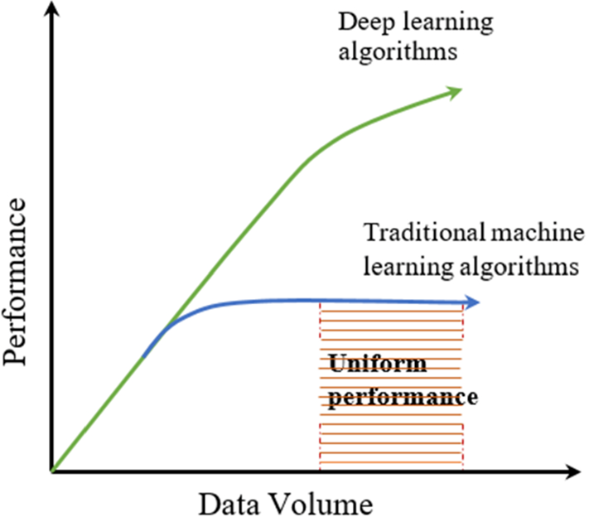
Why Deep Neural network
Notes:
Banyak varian data bisa dihandle dengan baik,

Slide 18
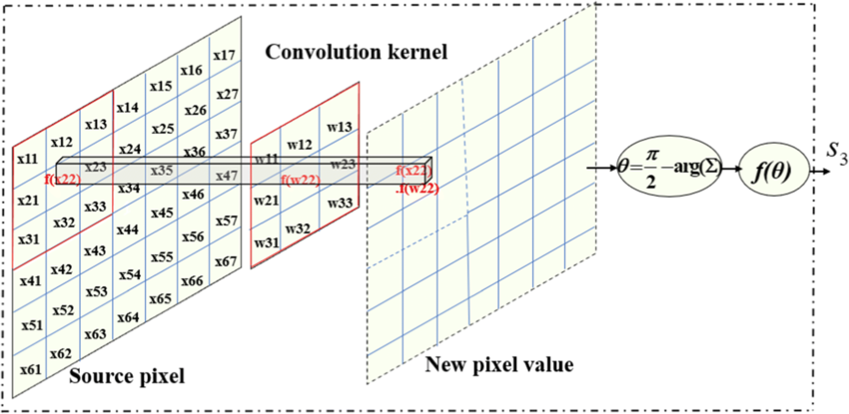
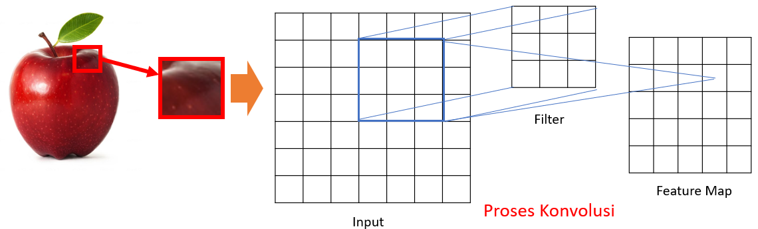
Convolutional Neural Network
CNN merupakan salah satu varian Neural Network dengan beberapa layer konvolusi dan layer lainnya.
Layer konvolusi mempunyai sejumlah filter yang mengaplikasikan operasi konvolusi.

Slide 19
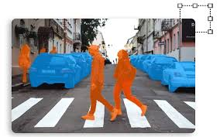
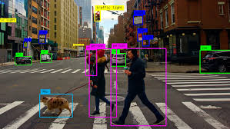
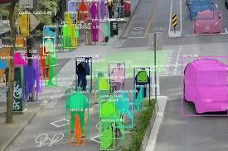
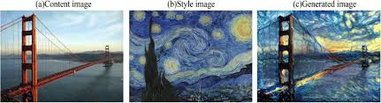
Convolutional Neural Network applications
Object Detection
Image Segmentation
Transfer style

Slide 20
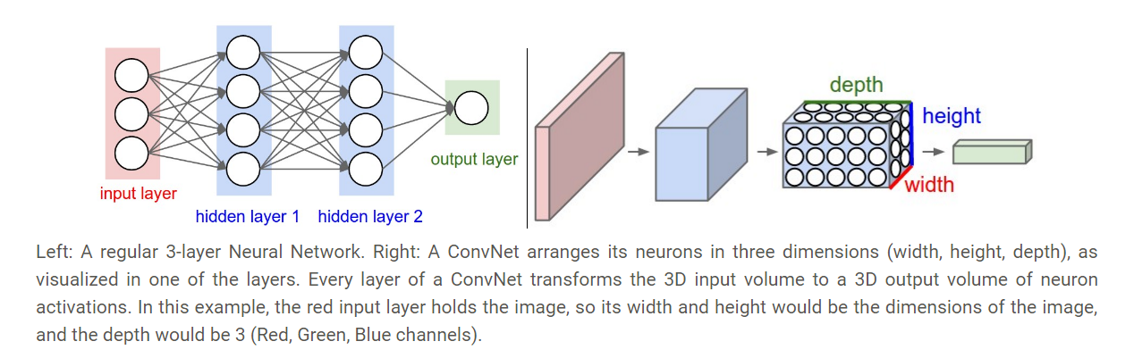
Dense neural network and Convolutional neural network

Slide 21
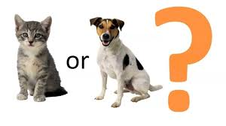
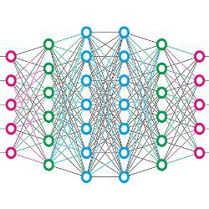
A simple CNN structure
Convolution
motor
mobil
Max Pooling
Dapat dilakukan proses ini secara berulang
Convolution
Fully connected layer
Max Pooling
Flatten

Slide 22
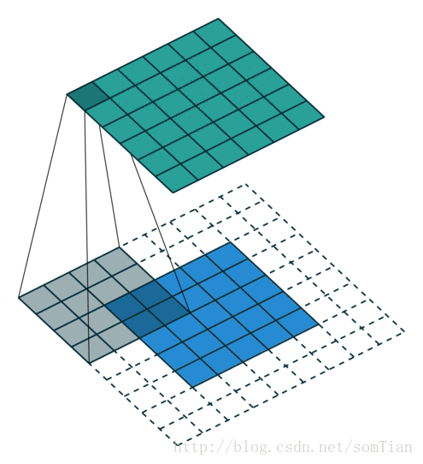

CONVOLUTIONAL KERNEL
$$\left(I∗K\right)\left(i,j\right)=\sum_{m}{\sum_{n}{I\left(m,n\right)K\left(i+m,j+n\right)}}$$
1 | 0 | 0 | 0 | 0 | 1
0 | 1 | 0 | 0 | 1 | 0
0 | 0 | 1 | 1 | 0 | 0
1 | 0 | 0 | 0 | 1 | 0
0 | 1 | 0 | 0 | 1 | 0
0 | 0 | 1 | 0 | 1 | 0
1 | -1 | -1
-1 | 1 | -1
-1 | -1 | 1
*
K
I

Slide 23
Convolutional process
Image
Convoluted Feature (Activation Map)
30 | 30 | 30 | 0 | 0 | 0
30 | 30 | 30 | 0 | 0 | 0
30 | 30 | 30 | 0 | 0 | 0
30 | 30 | 30 | 0 | 0 | 0
30 | 30 | 30 | 0 | 0 | 0
30 | 30 | 30 | 0 | 0 | 0
Filter
0 | 30 | 30 | 0
0 | 30 | 30 | 0
0 | 30 | 30 | 0
0 | 30 | 30 | 0
1 | 0 | -1
1 | 0 | -1
1 | 0 | -1
*
=

Slide 24
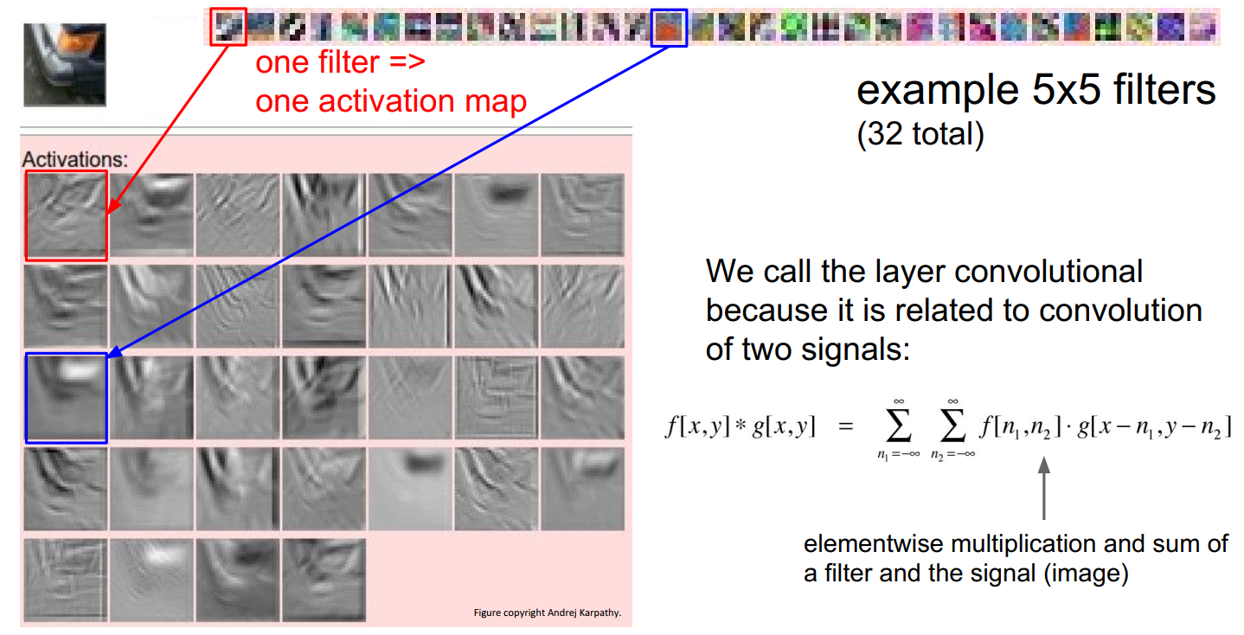
CONVOLUTIONAL PROCESS

Slide 25
CONVOLUTED FEATURE SIZe
The size of the output image resulting from the convolution process can be calculated using the following formula:
Example:
((N - F)/s) + 1 stride =1 ➔ ((5-3)/1) + 1 = 3
N: input size stride= 2 ➔ ((5-3)/2) + 1 = 2
F: filter size
s: stride
Stride adalah besarnya step yang digunakan ketika melakukan sliding filter

Slide 26
Convolution process
Parameters:
Input: 6
Filter Kernel:3
Stride:1
1 | -1 | -1
-1 | 1 | -1
-1 | -1 | 1
1 | 0 | 0 | 0 | 0 | 1
0 | 1 | 0 | 0 | 1 | 0
0 | 0 | 1 | 1 | 0 | 0
1 | 0 | 0 | 0 | 1 | 0
0 | 1 | 0 | 0 | 1 | 0
0 | 0 | 1 | 0 | 1 | 0
Filter 1
-1 | 1 | -1
-1 | 1 | -1
-1 | 1 | -1
Filter 2
……
Citra 6 x 6

Slide 27
Convolution process
stride=1
Parameters:
Input: 6
Filter Kernel:3
Stride:1
1 | 0 | 0 | 0 | 0 | 1
0 | 1 | 0 | 0 | 1 | 0
0 | 0 | 1 | 1 | 0 | 0
1 | 0 | 0 | 0 | 1 | 0
0 | 1 | 0 | 0 | 1 | 0
0 | 0 | 1 | 0 | 1 | 0
3
-1
-3
-1
-3
1
0
-3
1 | -1 | -1
-1 | 1 | -1
-1 | -1 | 1
-3
-3
0
1
Image 6 x 6
3
-2
-2
-1
Filter 1

Slide 28
Convolution process
Parameters:
Input: 6
Filter Kernel:3
Stride:1
1 | 0 | 0 | 0 | 0 | 1
0 | 1 | 0 | 0 | 1 | 0
0 | 0 | 1 | 1 | 0 | 0
1 | 0 | 0 | 0 | 1 | 0
0 | 1 | 0 | 0 | 1 | 0
0 | 0 | 1 | 0 | 1 | 0
3
-1
-3
-1
-1
-1
-1
-1
-3
1
0
-3
-1
-1
-2
1
Feature
Map
-3
-3
0
1
-1 | 1 | -1
-1 | 1 | -1
-1 | 1 | -1
-1
-1
-2
1
3
-2
-2
-1
-1
0
-4
3
Image 6 x 6
Filter 2
Two images 4 x 4
create 2 feature map

Slide 29
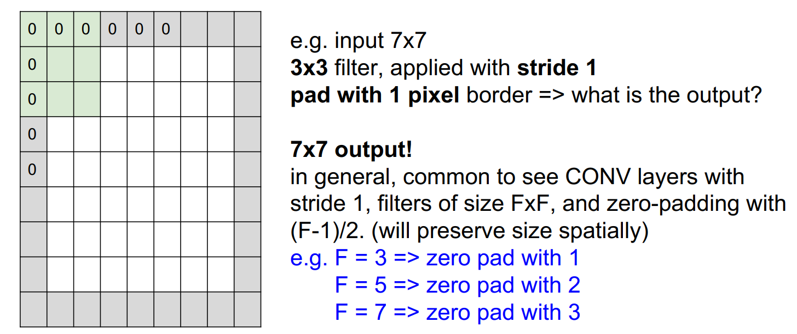
Convolution process : zero padding

Slide 30
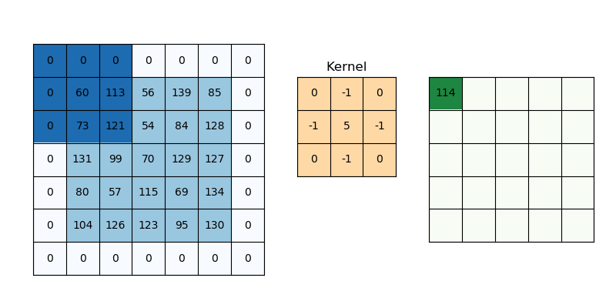
Convolution process : zero padding

Slide 31
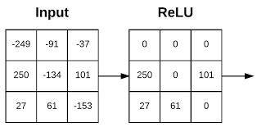
Rectified Linear function
The rectified linear activation function or ReLU for short is a piecewise linear function that will output the input directly if it is positive, otherwise, it will output zero.
Fast computing
Infinite sigmoid
Handles vanishing gradients
$$a$$
f
$$a=x$$
$$a=0$$
$$x$$

Slide 32
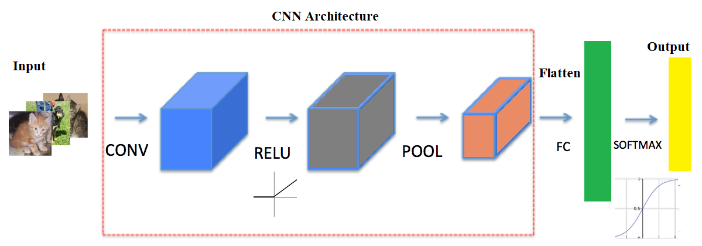

Rectified Linear function
The rectified linear activation function or ReLU for short is a piecewise linear function that will output the input directly if it is positive, otherwise, it will output zero.
Fast computing
Infinite sigmoid
Handles vanishing gradients

Slide 33
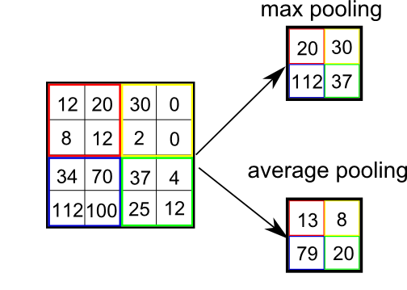
Pooling layer
Pooling layer is used to reduce image size to be smaller (downsample) and extract salient features.
Two types:
Max Pooling
Average Pooling
Notes:
Purpose: find the most significant value to be used as a feature

Slide 34
Pooling layer
Max Pooling
Filter: 2x2
Stride:2
Feature Map
3
-1
-3
-1
-1
-1
-1
-1
-3
1
0
-3
-1
-1
-2
1
-3
-3
0
1
-1
-1
-2
1
3
-2
-2
-1
-1
0
-4
3

Slide 35

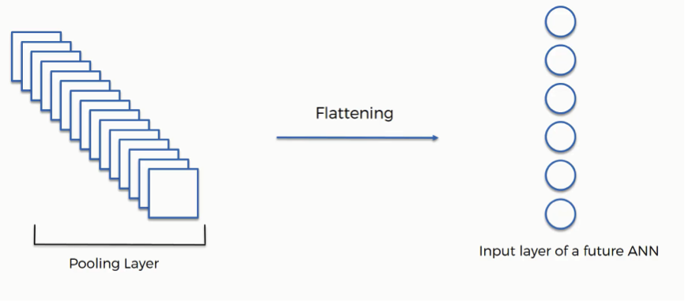
Fully connected layer
A fully connected layer refers to a neural network in which each neuron applies a linear transformation to the input vector through a weights matrix.
As a result, all possible connections layer-to-layer are present, meaning every input of the input vector influences every output of the output vector.
Flat
ten
Fully Connected Network
Output
https://cs.stanford.edu/people/karpathy/convnetjs/demo/cifar10.html
https://medium.com/@muhammadshoaibali/flattening-cnn-layers-for-neural-network-694a232eda6a

Slide 36
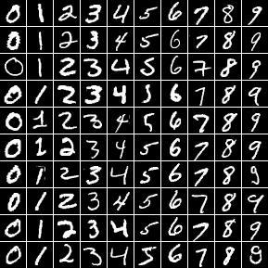
MNIST dataset
The MNIST database of handwritten digits, available from this page:
55,000 training data
10,000 test data
5,000 validation data
It is a subset of a larger set available from NIST.
The digits have been size-normalized (28x28) and centered in a fixed-size image.

Slide 37
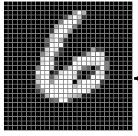


LeNet-5 for MNIST
→ 6
More : https://www.youtube.com/watch?v=pj9-rr1wDhM&t=41s
Notes:
Tambahkan padding agar ukuran input menjadi 32x32

Slide 38
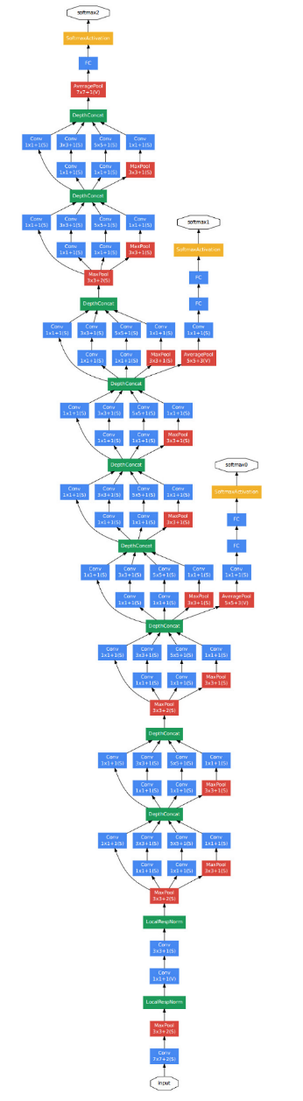


CNN Architectures
VGG-16
GoogleNet
ResNet

Slide 39

CNN Architecture over a timeline

Slide 40
Thank you!
PDS
SDN
NFV
Computer Vision
Thank you For being a great class!
https://github.com/siagianp
https://github.com/amelcharolinesgn2/IoT_simulator-mqtt-NodeRed
https://www.youtube.com/@AmelOline/videos
Notes:
https://medium.com/buildpiper/simplifying-containerization-with-docker-run-command-2f74e114f42a
https://github.com/IBA-Group-IT/IoT-data-simulator
https://www.bevywise.com/blog/docker-mqtt-broker-easy-service-manageability/

